Slide 1
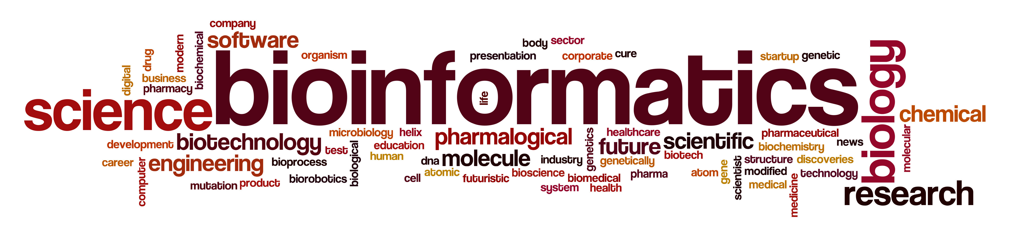
CALIBIR Bootcamp 2023:
translational
Nicholette (Palmer) Allred
Professor, Department of Biochemistry
nallred@wakehealth.edu

Slide 2
Translational Bioinformatics
Development of storage, analytic and interpretive methods to optimize the transformation of increasingly voluminous genomic (proteomic, transcriptomic, metabolomic, epigenomic, enviromic, interactomic, pharmacogenomic, phenomics) and biomedical data into proactive, predictive, preventive and participatory health
-American Medical Informatics Association

Slide 3

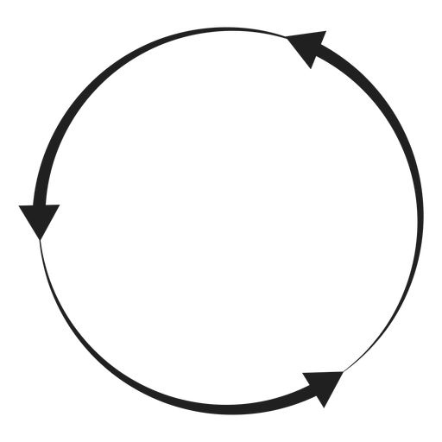

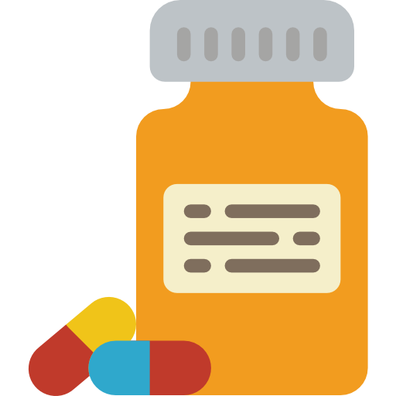
Translational Bioinformatics
Databases (Molecular Data)
Knowledge Bases
Precision Medicine
Improved Diagnostics
Bench
Bedside
Bioinformatics
Statistics
AI-based Technologies
Clinical Implications
Adapted from Translational Biotechnology: A Journey from Laboratory to Clinics (2021)

Slide 4
Components of Translational Research
Bootcamp #1: Healthcare Informatics
Drs. Wells, Ostaiewski, Ford
Bootcamp #3: Clinical Informatics
Drs. Khanna
Big Data
Health Care
Omics
Publicly available repositories
Analytical Tools
Biostatistics
Artificial intelligence-based technologies
Bootcamp #5: Artificial Intelligence
Drs. Rezapour, Annanurov & Sajjad

Slide 5
Translational Bioinformatics
Pharmacodynamic Biomarker
For identifying drug effects and mechanisms of action
Diagnostic Biomarker
Predictive Biomarker
For diagnosis and screening of diseases
Biomarker
For predicting disease risk or drug efficacy
For prediction of disease progression and pathways
For identifying primary or acquired resistance to drugs
Prognostic Biomarker
Resistance Biomarker
Adapted from Translational Biotechnology: A Journey from Laboratory to Clinics (2021)

Slide 6
Omics
Omics is a rapidly evolving, multi-disciplinary, and emerging field that encompasses genomics, epigenomics, transcriptomics, proteomics, and metabolomics.
Each omics technology offers the possibility to understand and view biology from a global perspective.
High-throughput methodologies can rapidly provide a global picture of the processes within cells at multiple levels, allowing for accelerated discoveries in health and disease.

Slide 7
Omics
The ultimate potential of the cell
What is possible
DNA
The current direction of the cell
What appears to
be happening
RNA
Information
The functional capability of the cell
What makes it
happen
Proteins
Data
The limiting currency of the cell
Metabolites
What is happening

Slide 8
The Central Dogma of Biology
Genotyping, genotype arrays, whole exome sequencing, whole genome sequencing
Methylation arrays, RRBS,
CHIPseq, microRNA sequencing
Genome
Epigenome
Transcriptome
expression arrays, mRNA sequencing
Standard laboratory assays,
mass spectrometry
Western blots, ELISAs, chromatography,
mass spectrometry
Proteome
Metabolome
Phenotype
Clinical disease, trait, health measure

Slide 9
Utility for Understanding Disease
DNA
Largely stable over time and across tissues
Highly predictive for monogenic disorders, less so complex adult-onset traits
Transcripts, protein levels, epigenetics, metabolomics
More challenging to collect
Directionality of effect unclear
Tissue and cell-type specific
Changes over time and in response to environment

Slide 10
The Central Dogma of Biology
Genotyping, genotype arrays, whole exome sequencing, whole genome sequencing
Methylation arrays, Methyl seq, RRBS,
CHIPseq, microRNA sequencing
Genome
Epigenome
Transcriptome
expression arrays, mRNA sequencing
Standard laboratory assays,
mass spectrometry
Western blots, ELISAs, chromatography,
mass spectrometry
Proteome
Metabolome
Phenotype
Clinical disease, trait, health measure

Slide 11
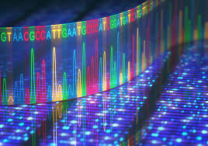
Sequence-based Omics

Slide 12
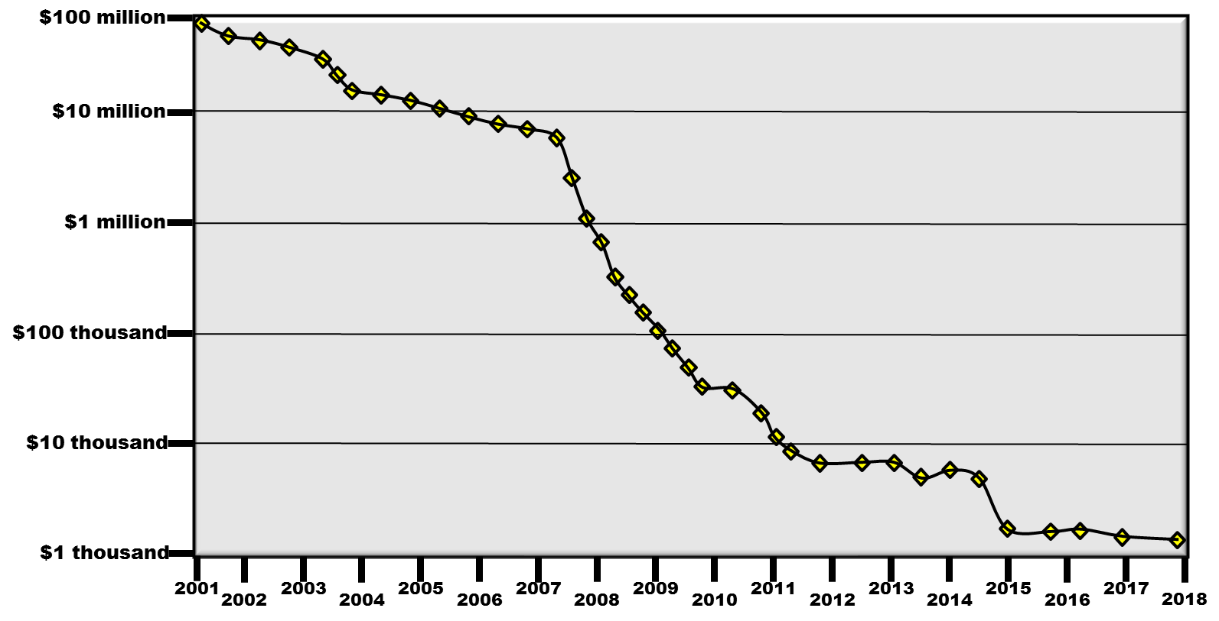
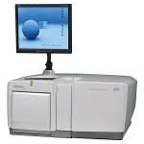

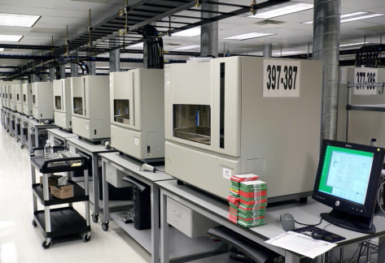
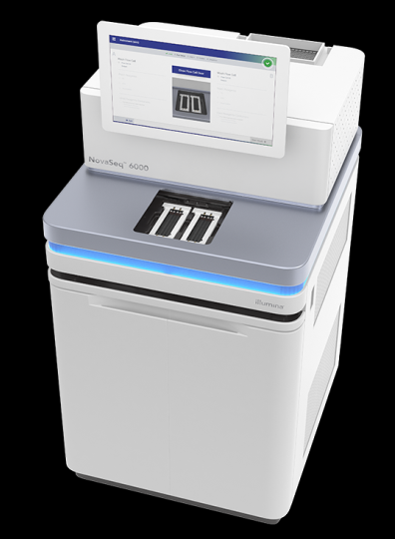
History Sequence-based Omics
Cost over time: First human genome sequence draft took ~10 years (1990-2000)*, $2.7 billion and involved 20 genome sequencing centers to complete
2005 – Introduction of Next Generation
DNA sequencing
NovaSeq
~ 48 human genomes
~ 45 hours
~$1500/genome
*Nature 409, 860–921 (2001)

Slide 13
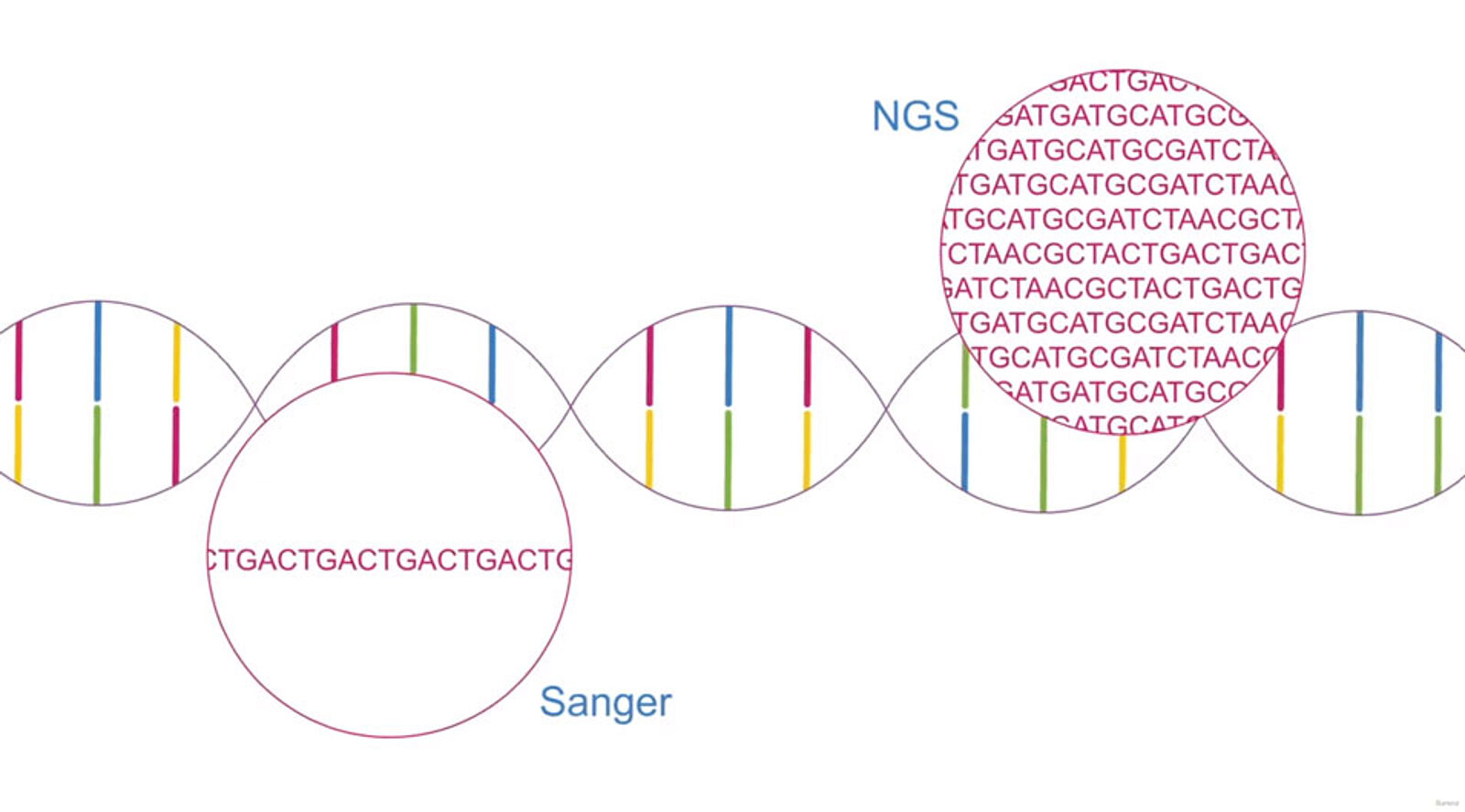
DNA Sequencing

Slide 14
DNA Sequencing
Sample
blood, skin, buccal swabs, saliva, tissue; relatively stable
Cost
30X coverage >$700/sample (germline applications)
Data
Raw data >1Tb (.bcl2, .fastq; cloud computing)
Processed data: Mb-Gb (.bam, .vcf)
Annotation files: Mb (annovar)
Repositories
GenBank – hundreds of organisms sequenced
dbGAP – interaction of genotype-phenotype

Slide 15
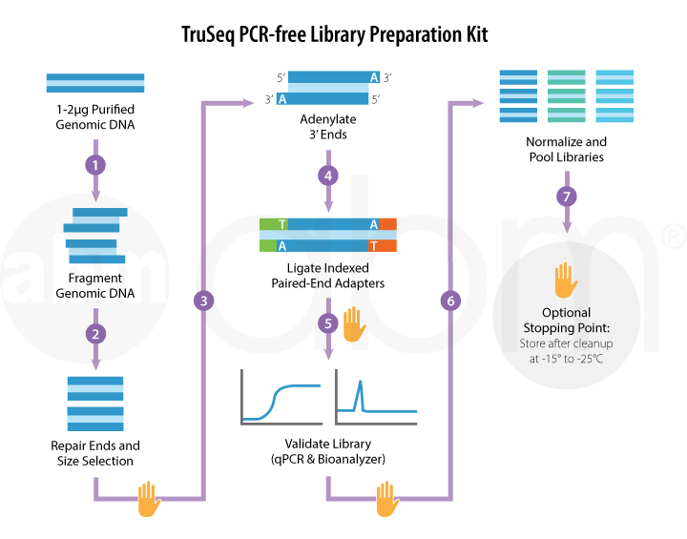
DNA Sequencing
https://info.abmgood.com/next-generation-sequencing-ngs-experimental-design

Slide 16
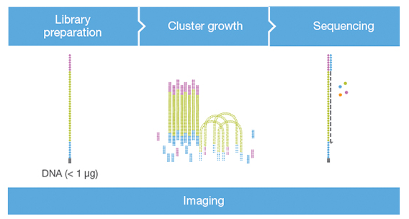
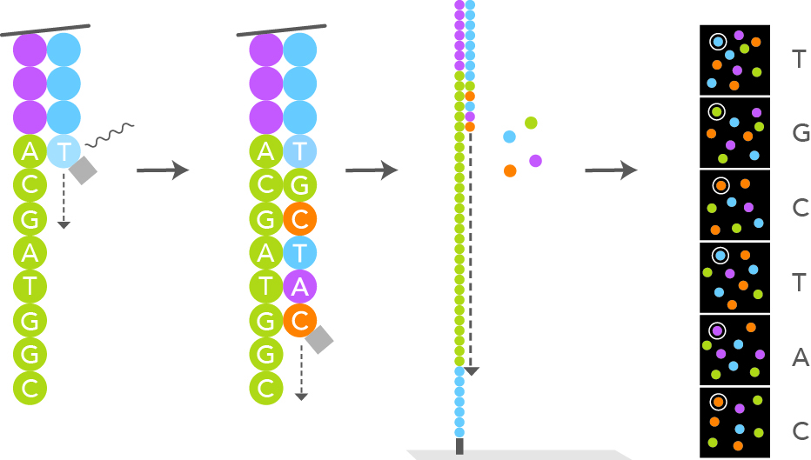
Sequencing by Synthesis
https://youtu.be/fCd6B5HRaZ8

Slide 17
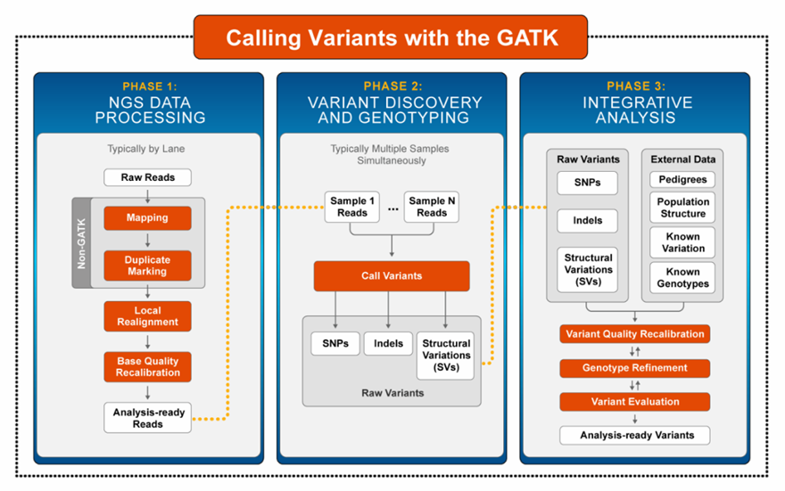
GATK Best Practices
A workflow that has historically focused on variant discovery --that is, the existence of genomic variants in one or more samples in a cohorts-- and consistently delivers high quality results when applied appropriately
FASTQ file – from raw NGS reads
VCF file:
genomic variation
SAM/BAM file:
aligned NGS reads
.sam file: Uncompressed text file
.bam file: Compressed and indexed file
VCF Files
Genome Res. 2010 Sep; 20(9): 1297–1303.; Nature Genetics 43, 491–498 (2011).; Curr Protoc Bioinformatics. 2013;43:11.10.1-33.
https://software.broadinstitute.org/gatk/documentation/presentations.php

Slide 18
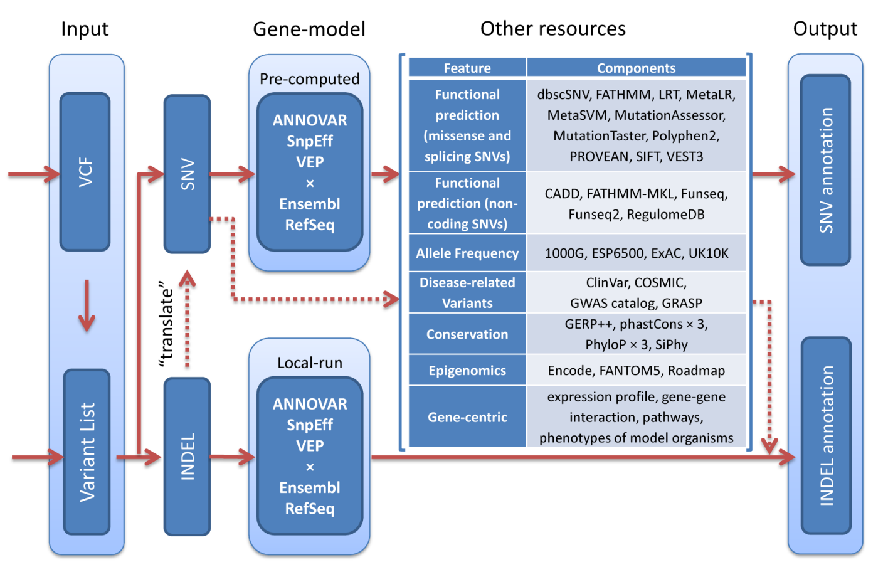
WGSA
J Med Genet. 2016 February; 53(2) 111-112.

Slide 19
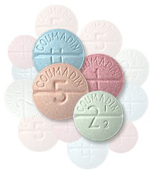

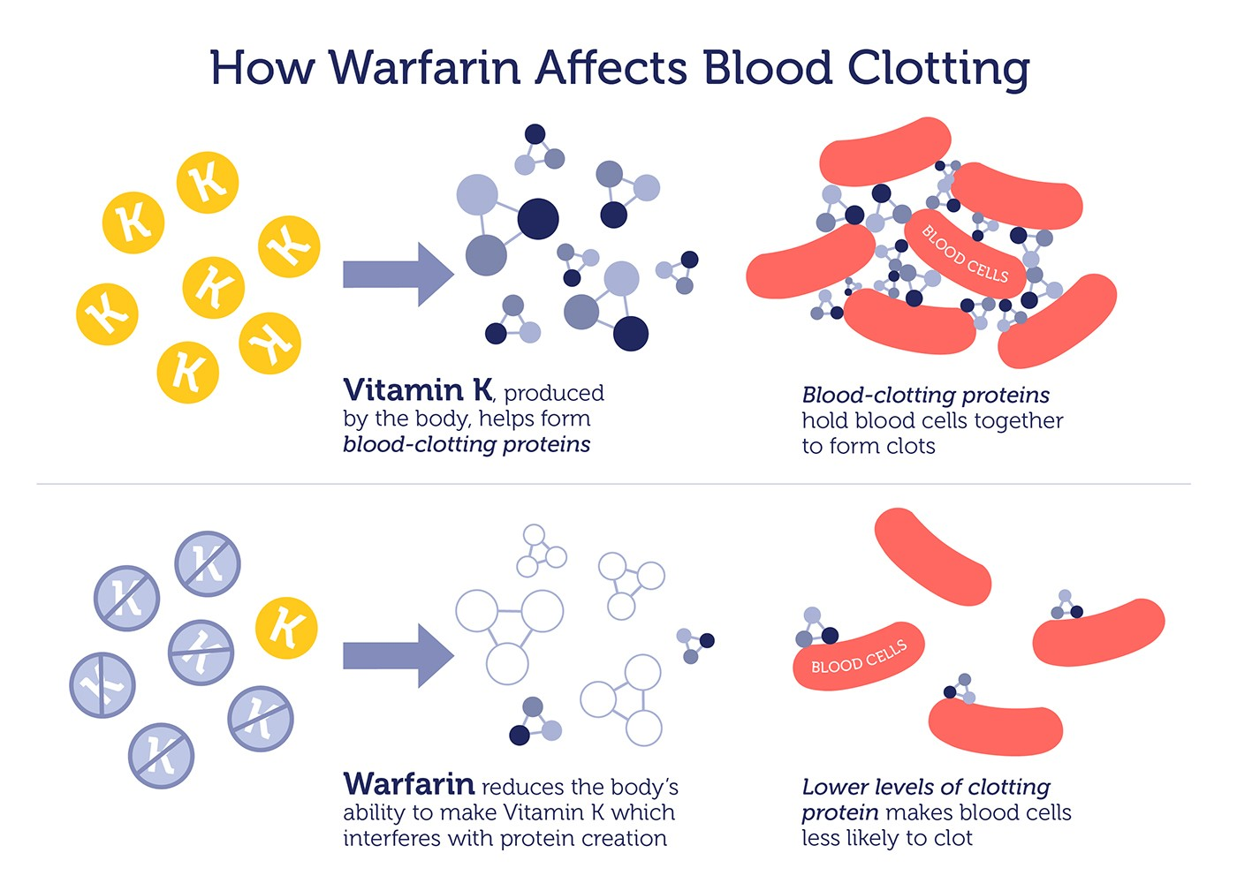
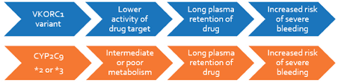
Application Warfarin Dosing
1948
1954
Conditions caused by clots
Stroke
Pulmonary Embolism
Deep Vein Thrombosis

Slide 20
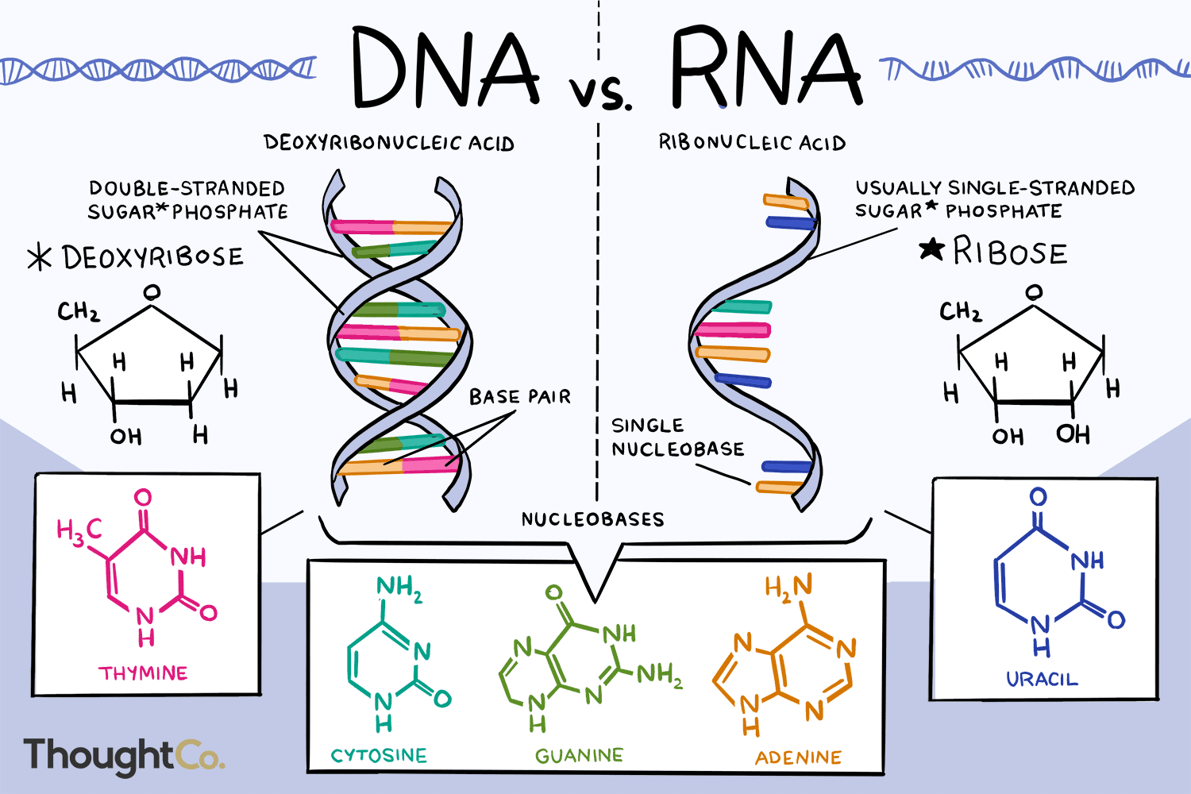
RNA Sequencing

Slide 21
RNA Sequencing
Sample
blood, skin, buccal swabs, saliva, tissue; relatively unstable
Cost
20M-35M reads - $350 - $450/sample
Data
Raw data >1Tb (flow cell dependent; .bcl2, .fastq; cloud computing)
Gene Expression Data
GEO, ArrayExpress

Slide 22
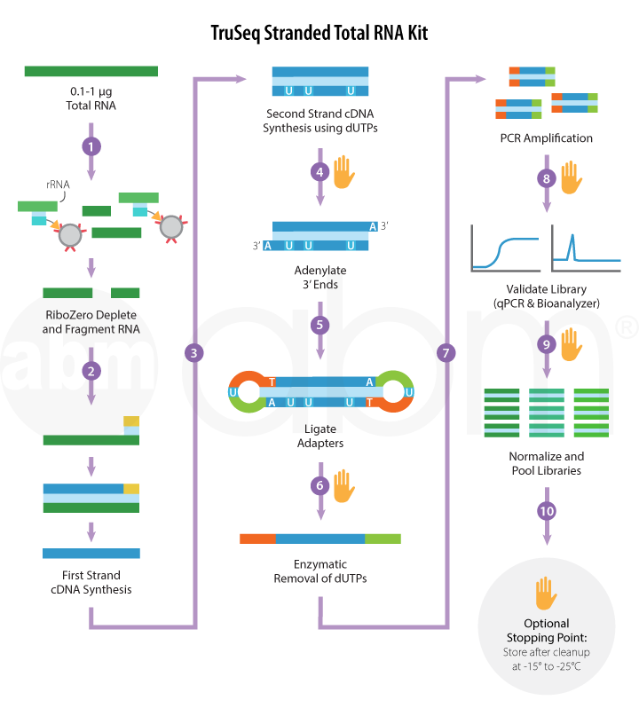
RNA Sequencing
https://info.abmgood.com/next-generation-sequencing-ngs-experimental-design

Slide 23
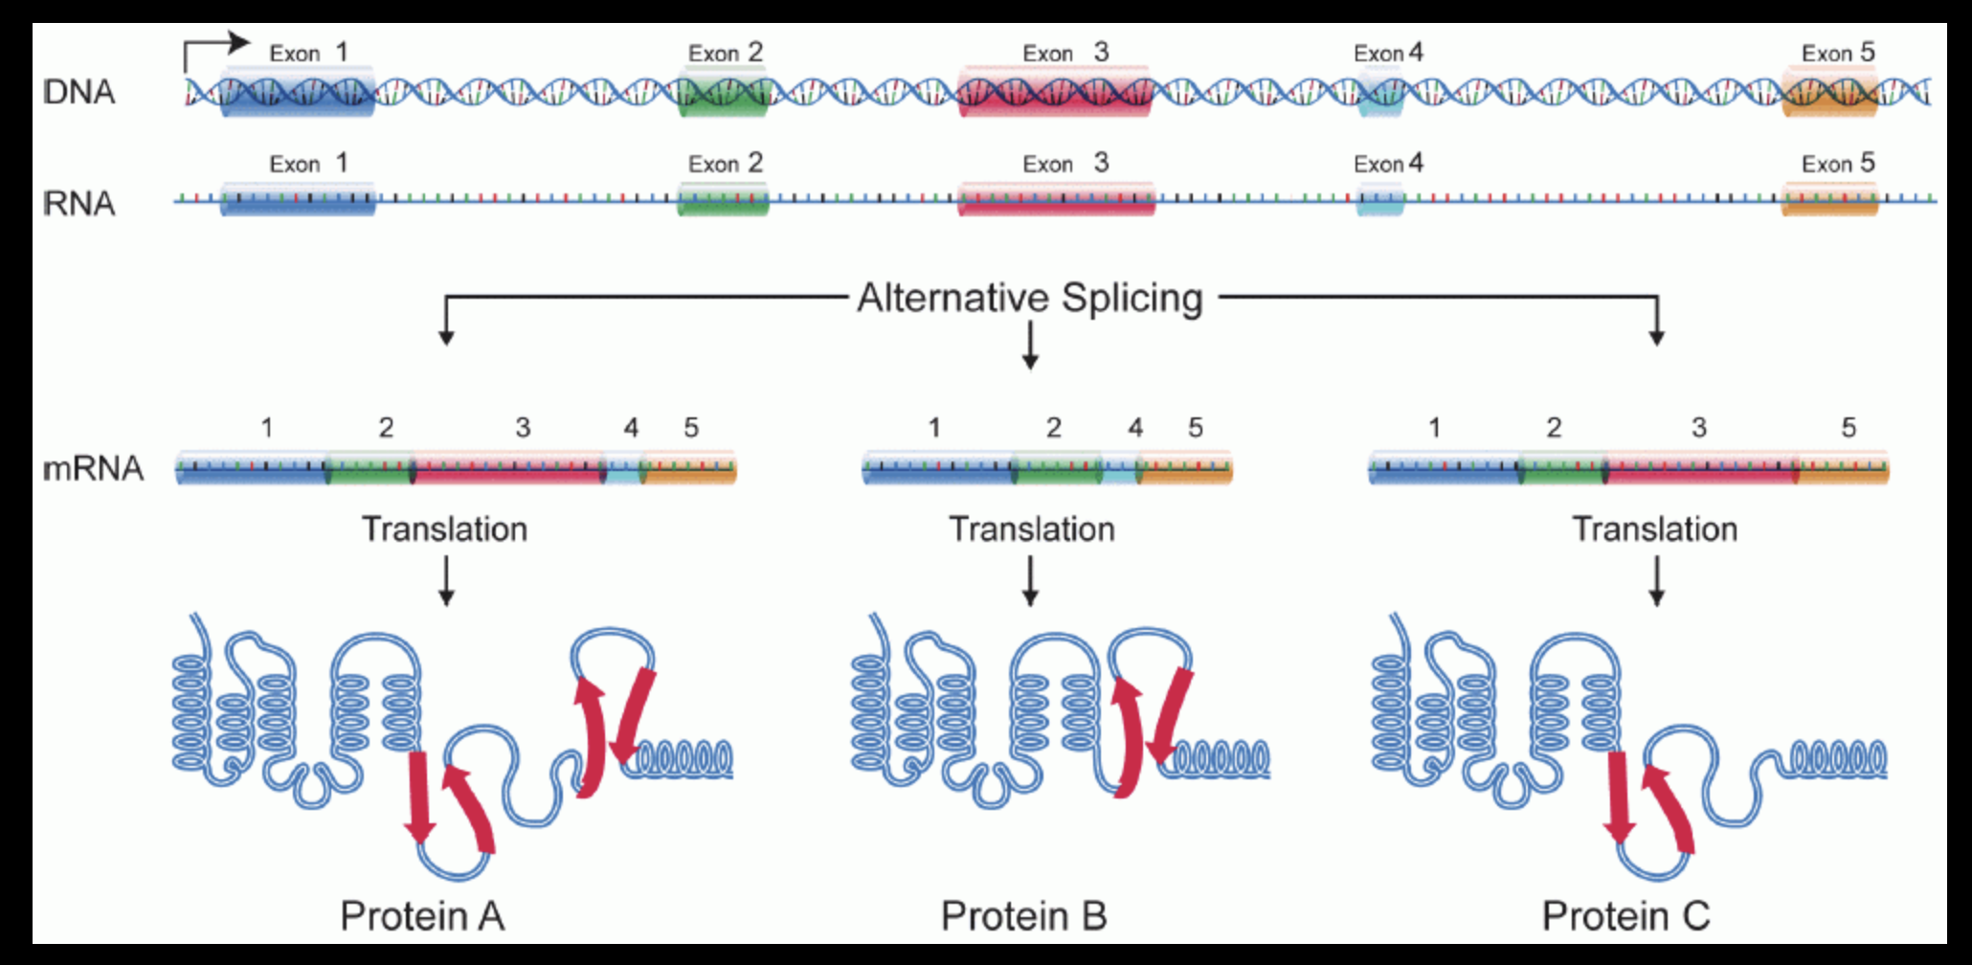
Transcript and Transcript Splice Variant Synthesis is Dynamic
DNA variants
Tissue
Environment
Time

Slide 24
Why analyze the transcriptome?
Snap-shot of entire transcriptome
Cell/Tissue specific
Evidence of genetic regulation
Transcript start site variants
Splice variants
RNA editing (with very high coverage + genome)
Very sensitive, quantitative
Accurate identification of transcripts based on sequence identity

Slide 25
Limitations of transcriptome analysis
Transcript abundance does not indicate transcript translational rates
Transcript abundance does not always correlate with protein abundance
Protein abundance or protein post-translational modifications may be more biologically relevant than transcript abundance
There are currently no good algorithms to predict transcript-protein correlations

Slide 26
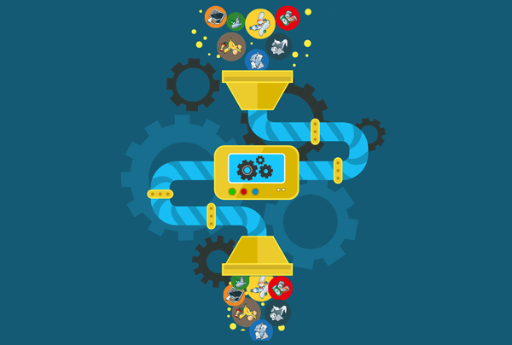
GIGO
RNA is finicky and unstable - stability differs by transcript

Slide 27
Sample Collection and Processing
Critical: Collect and snap freeze tissue samples as quickly as possible
Some RNA begins degrading immediately
Some RNA is very stable
Long processing times select for stable RNAs in your output
Tissue samples should never be thawed once frozen
RNA in tissue is more stable than as isolate RNA, even at -120ºC
How much tissue do you need?
Standard protocols ask for 10-20 mg of tissue
We’ve optimized RNA extraction protocols from 3-5 mg of tissue
Except adipose ~ 25 mg of tissue

Slide 28
Normalization of transcript data
Number of raw reads per gene influenced by transcript abundance & transcript length – need to take both into account to determine relative abundance of transcripts in datasets
Determine best fit for all transcripts in dataset
RPKM - Reads per Kilobase per Million reads
FPKM - Fragments per Kilobase per Million reads
TPM - Transcripts per Kilobase per Million reads
TMM - Trimmed Mean of M-values (typically used if there are a significant number of low abundance transcripts in the dataset)

Slide 29
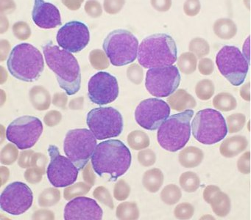
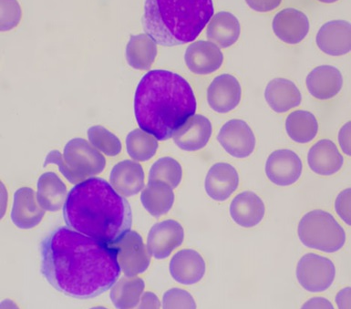
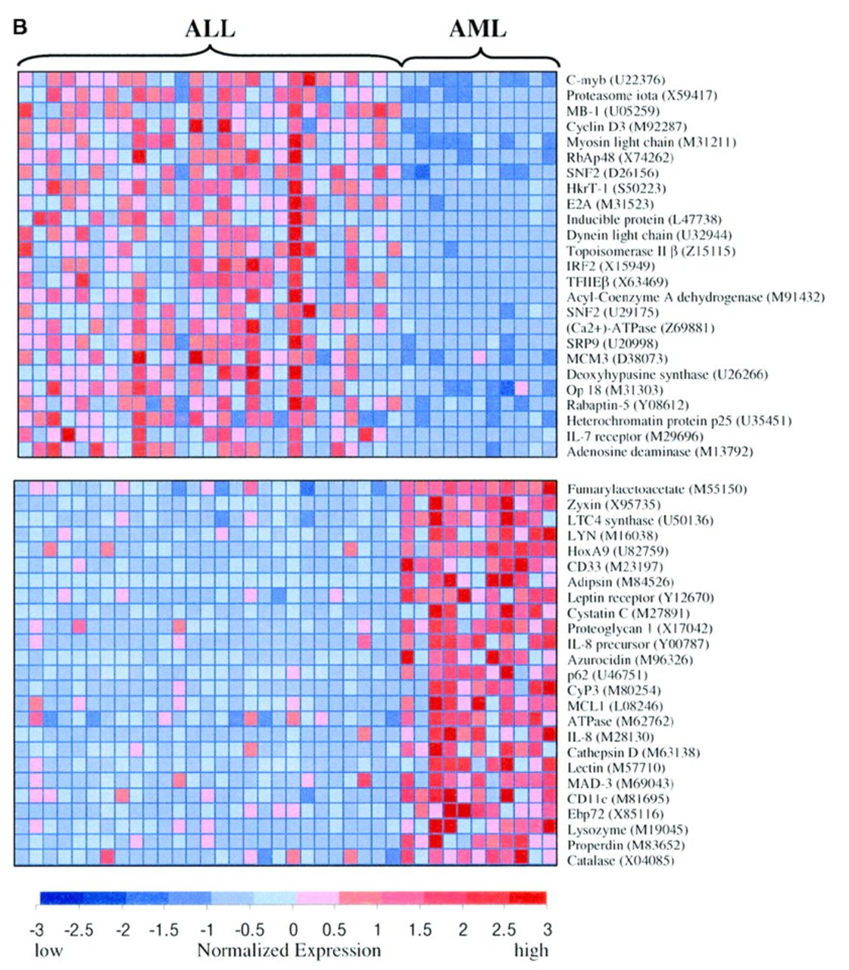
Application – Leukemia
ALL
 | ALL | AML
Age | Childhood | Adult
CBC | Lymphoblasts >20% | Myeloblasts >20%
Risk Factors | Radiation, EBV in infancy | Fanconi’s, Pesticides, Alkylating Agents
Treatment | Prolonged (years) Induction → multidrug chemo | Intensive (months) Induction → high-dose chemo
5 Year Survival | 69.9% | 29.5%
AML

Slide 30
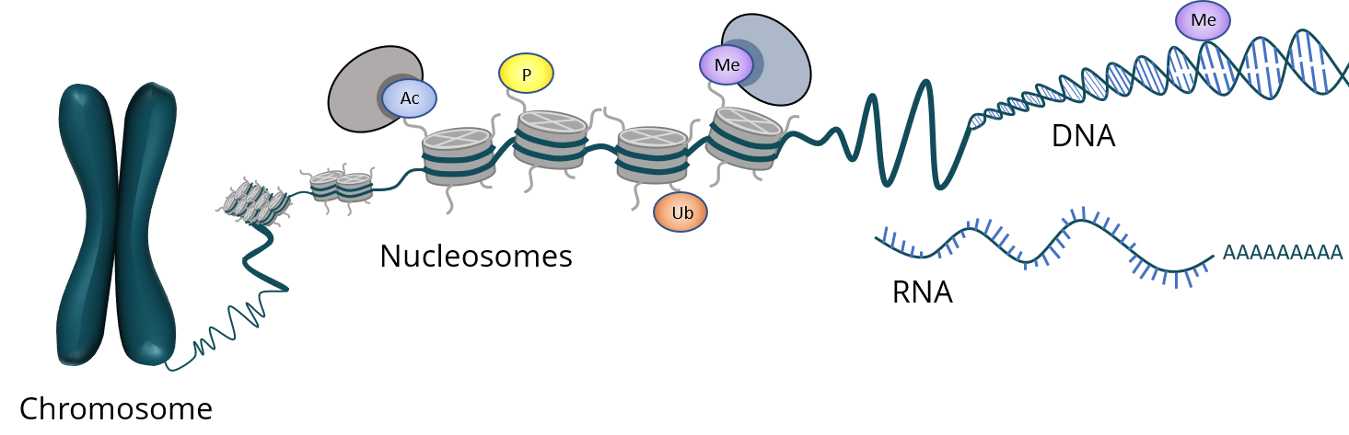
Epigenetics

Slide 31
Epigenetics
The study of heritable changes in gene function that occur without a change in the sequence of the DNA (A, C, G, T).
Some changes are transient and can be regulated by environmental factors (diet, chemicals, behaviors, etc.)
Alegría-Torres et al., Epigenomics (2011) 3(3), 267–277

Slide 32

DNA methylation
C’s of CpGs can be methylated and potentially affect gene transcription
Me
ATGACpGGTCACpGAT
Unmethylated
X
Methylated

Slide 33
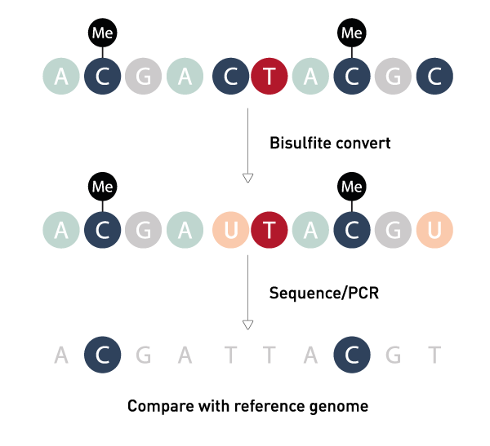
Bisulfite Conversion
Bisulfite Conversion
Sodium bisulfite deaminates cytosine residues
C → U
Sequencing - Agilent SureSelectXT Methyl-Seq
3.7 million CpG sites
~$730/sample, run in batches of 12 ($8,760)
Amplification by PCR

Slide 34
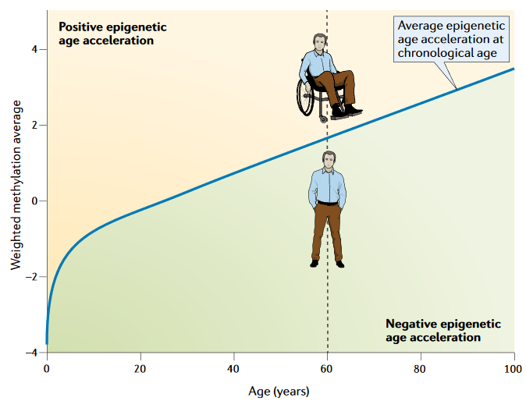
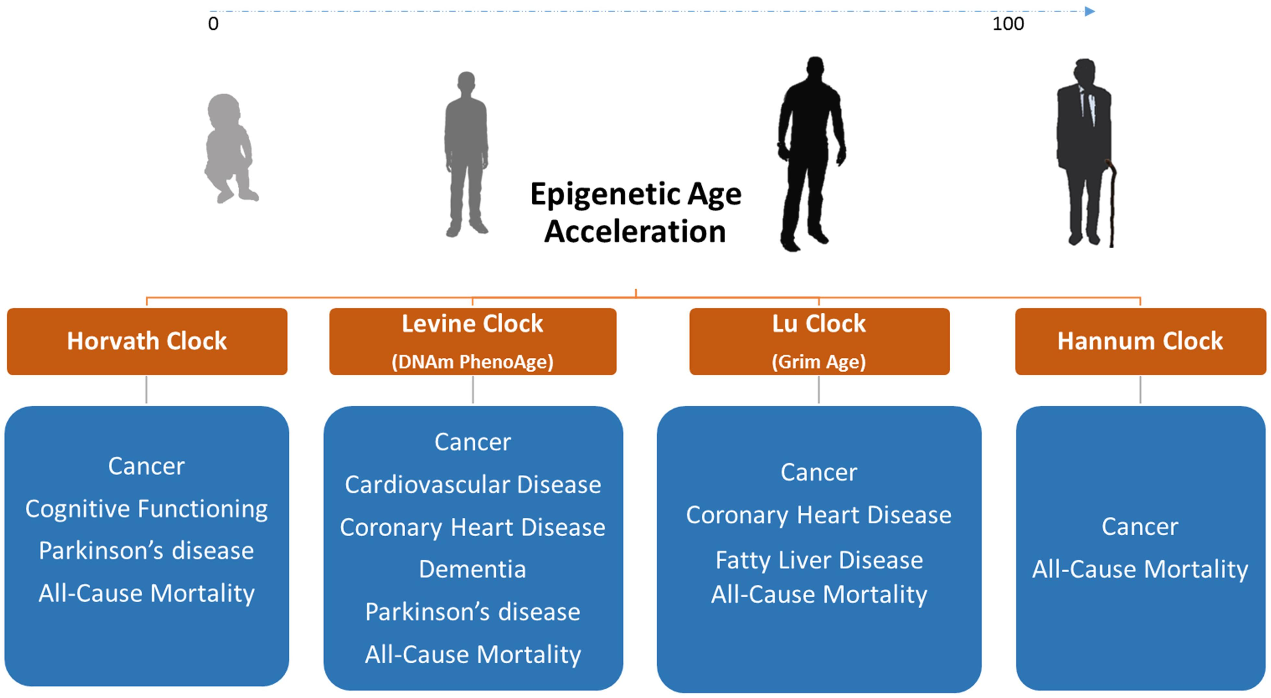
Application Methylation Clock for Aging
Do some behaviors or exposures affect healthy aging, based on changes in DNA methylation?
Nature Reviews Genetics volume 19, pages371–384 (2018)

Slide 35
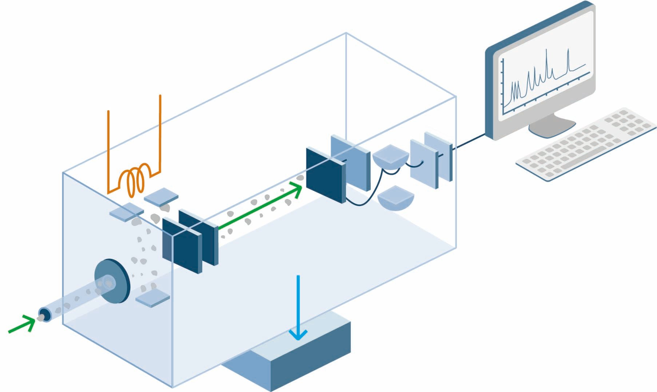
MS-based Omics

Slide 36
Mass Spectrometry (MS)
A mass spectrometer is a balance that measures the mass of ions
Useful for identifying and quantifying unknown small molecules
Can be done massively in parallel compared to other assays

Slide 37
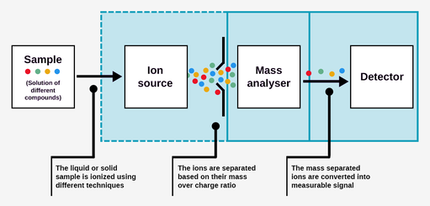
Mass Spectrometry
Separation techniques
GC
LC
Generation of ions
Electrospray Ionization (ESI)
Matrix-assisted laser desorption/ionization (MALDI)
Separation of ions
Quadrupole
Ion-trap
Time of Flight
Detection of ions
Electron multiplier
Photomultiplier
Thermo Q-Exactive is one of several mass spectrometers at Wake - https://youtu.be/K1VSYjuw6os

Slide 38
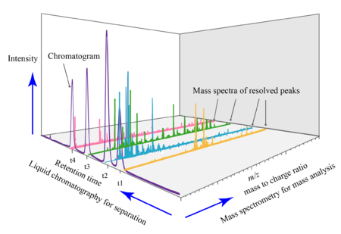
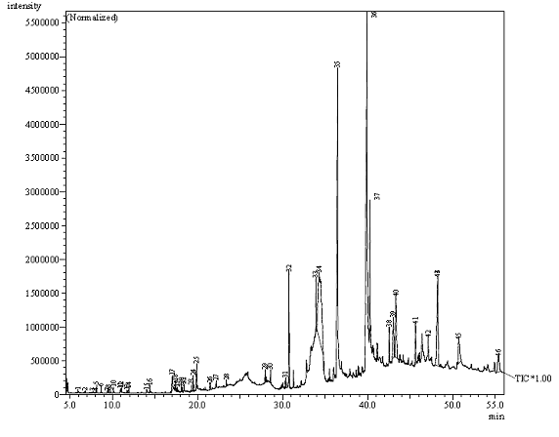
Mass Spectra

Slide 39
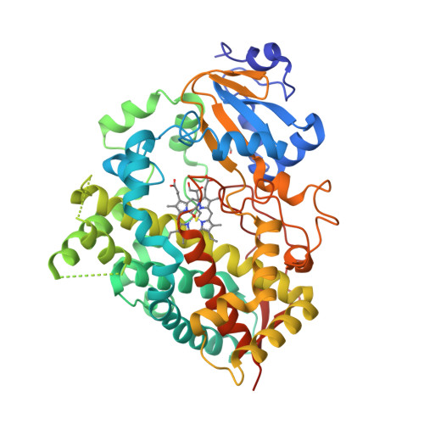
Proteomics

Slide 40
Why Proteins?
The majority of cellular processes are mediated by proteins (transcription factors, enzymes, receptors)
Abundance and activity of proteins are key drivers of biological processes
The overall correlation between RNA transcript levels and protein abundance is ~0.5
A LOT of genes/proteins (and the resulting cellular processes) are not regulated by transcriptional regulation, but by post-translational regulation (protein synthesis and degradation)
Protein activity and cellular localization are additional key factors in regulating cellular processes

Slide 41
Untargeted Proteomics Analyses
Identification of proteins present in complex samples (any species, any tissue)
Quantitative proteomics (cells, tissues, mitochondria, exosomes, microbiome)
Label-free quantification, isotopic labeling
Analysis of posttranslational modifications
You cannot select which proteins you analyze
Analysis is restricted to a subset of reasonably abundant proteins (1000-3000)

Slide 42
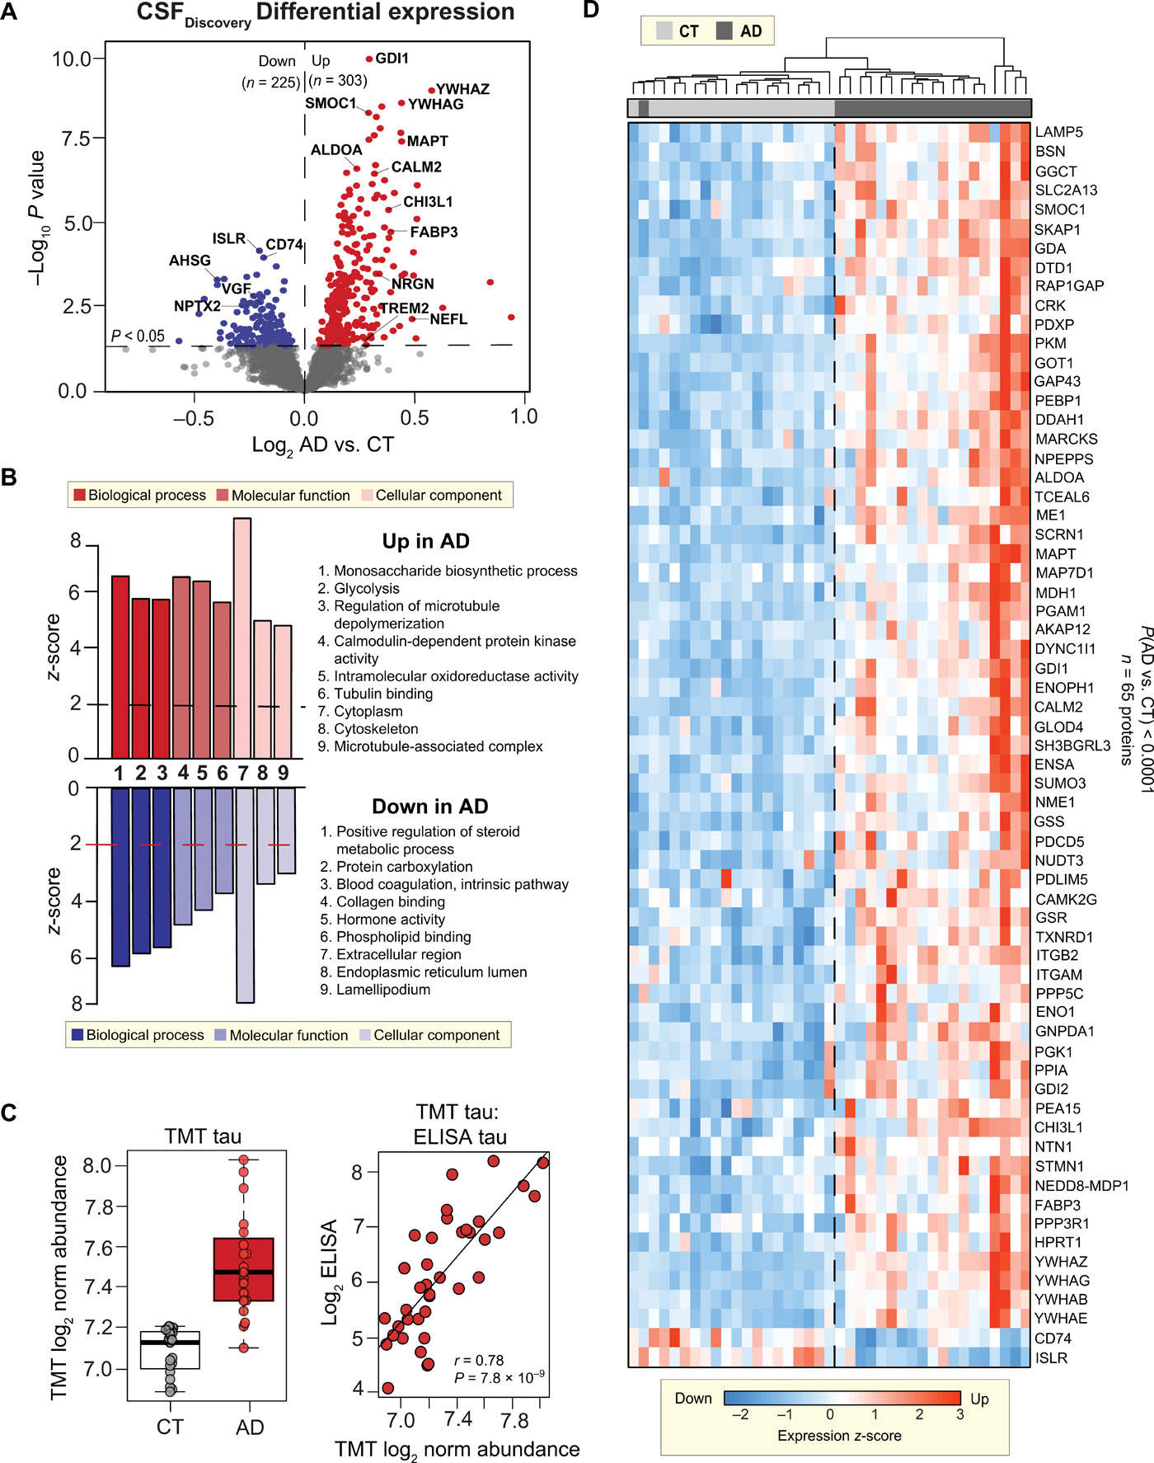
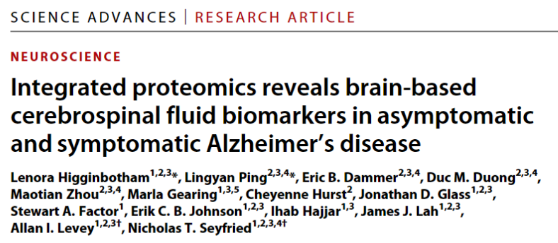
Application Alzheimer’s Disease
Sci Adv. 2020 Oct 21;6(43):eaaz9360.

Slide 43
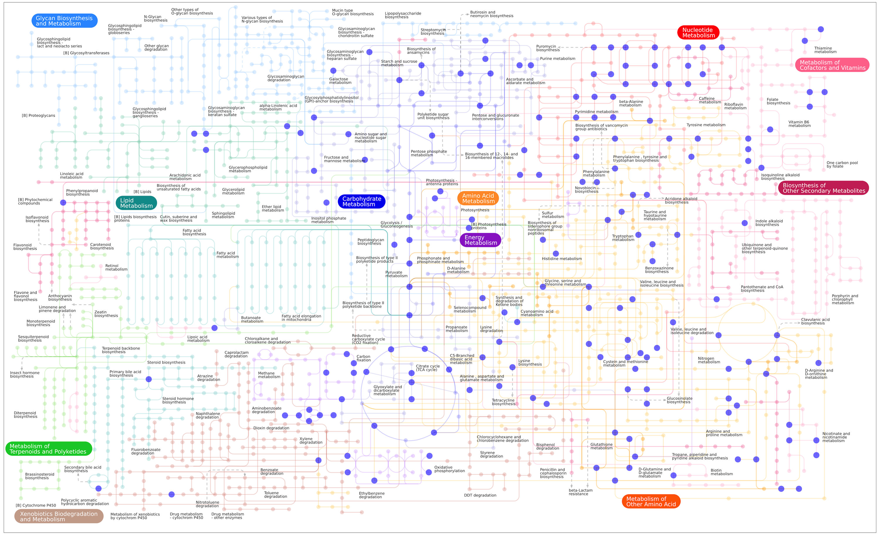
Metabolomics

Slide 44
What is Metabolomics?
The study of small molecules, metabolites, found in biofluids, bio-volatiles, cells, tissues or organisms
Collectively called the metabolome
Human Metabolome Database
18,557 metabolites detected and quantified
3,271 metabolites detected in but not quantified
82,274 metabolites expected
Provides a molecular phenotype or signature though a metabolic snapshot of your sample
Differs from other Omics in that the metabolites and their concentration are a direct reflection of the biochemical activity and metabolic state

Slide 45
Limitations
There is no one size fits all method to detect all metabolites
Within areas of instrumentation, there is no one method to capture all metabolites present.
Limit of detection → missing data

Slide 46
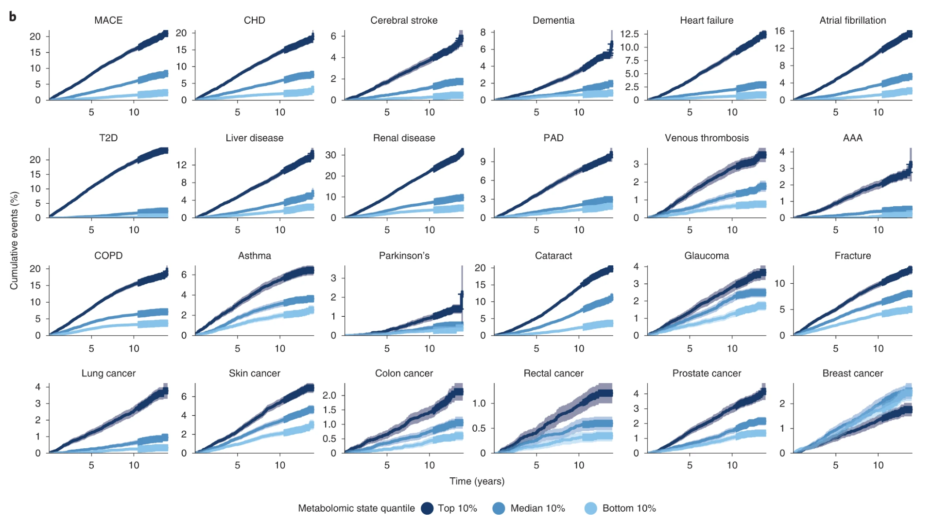
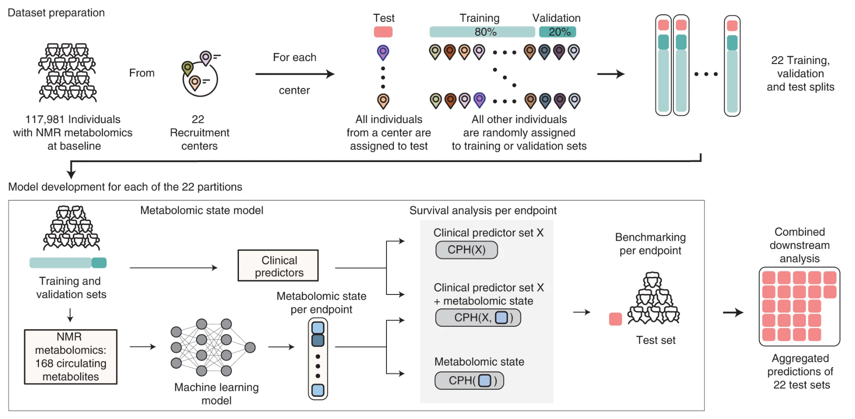
Application Metabolomic profiles predict individual multidisease outcomes
Nature Medicine volume 28, pages2309–2320 (2022)

Slide 47
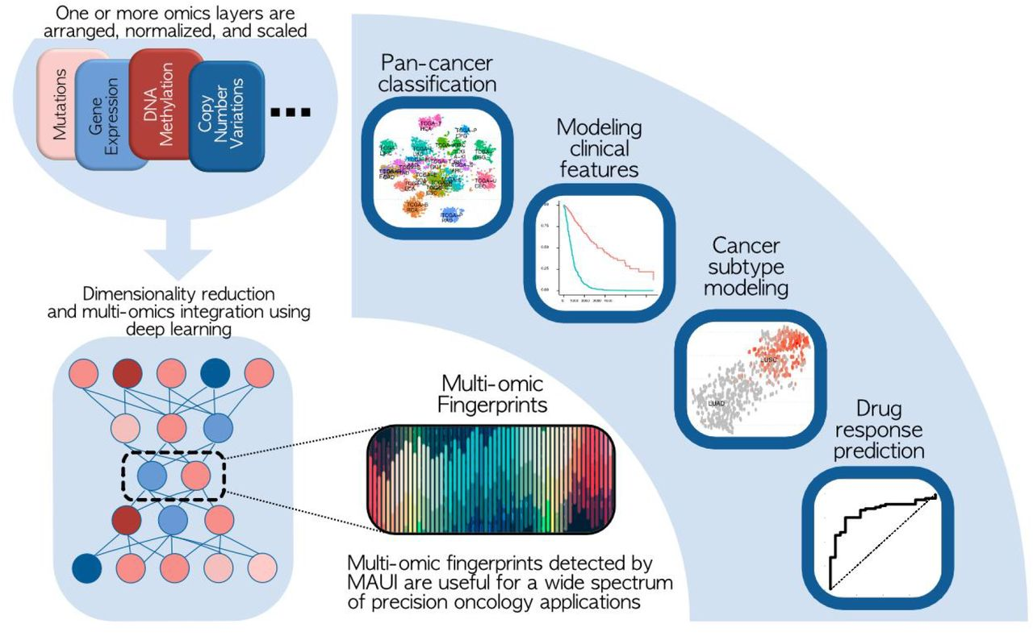
Integrating Results
Disease
Classification
Disease
Subtype
Modeling
Multi-omic fingerprint for precision medicine applications
Adapted from https://doi.org/10.1101/2021.09.29.462364

Slide 48
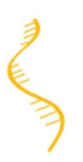
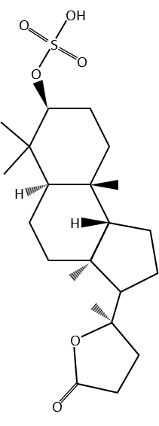
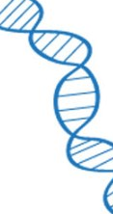
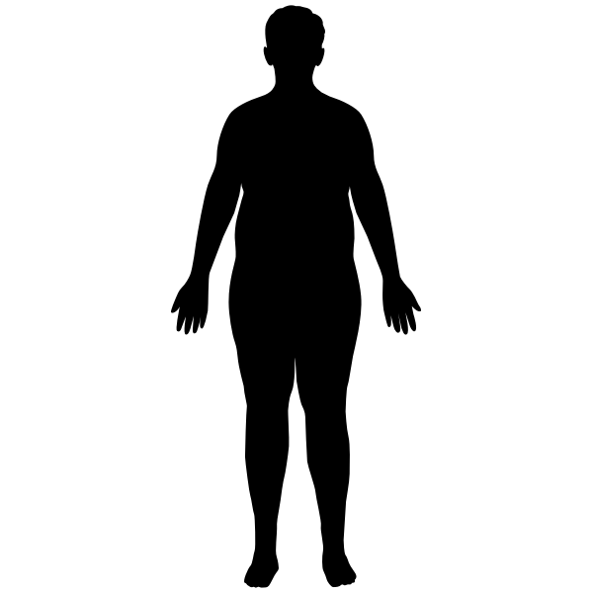
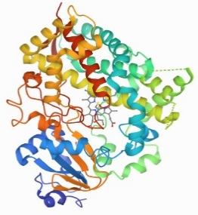
Application Metabolomic architecture of obesity implicates metabolonic lactone sulfate in cardiometabolic disease
Insulin Resistance
↓Insulin Sensitivity
↓Glucose Effectiveness
↑Fasting Glucose
↑HOMA_{IR}
CYP3A5
↓ Metabolic Clearance of Insulin
G
BMI
Waist Circumference
Subcutaneous Adipose
Visceral Adipose
STOP
Dyslipidemia
↑Triglycerides
↑Cholesterol
Metabolite
Metabolonic
Lactone Sulfate
Hypertension
DNA
rs776746
RNA
CYP3A5*3
Protein
CYP3A5
↑Pulse Pressure
↑DBP
Mol Metab. 2021 Dec;54:101342. doi: 10.1016/j.molmet.2021.101342.

Slide 49
Where are we going?
Multiomics
NHLBI TOPMed (180K samples)
UKBiobank (550K samples)
Geisinger Health System (MyCode) - sequence the exomes of 250,000 patients
Challenges
Data Standards - understanding, navigating, and using existing standards
Inter-interdisciplinary coordination and collaboration - medicine, biology, and computer science

Slide 50

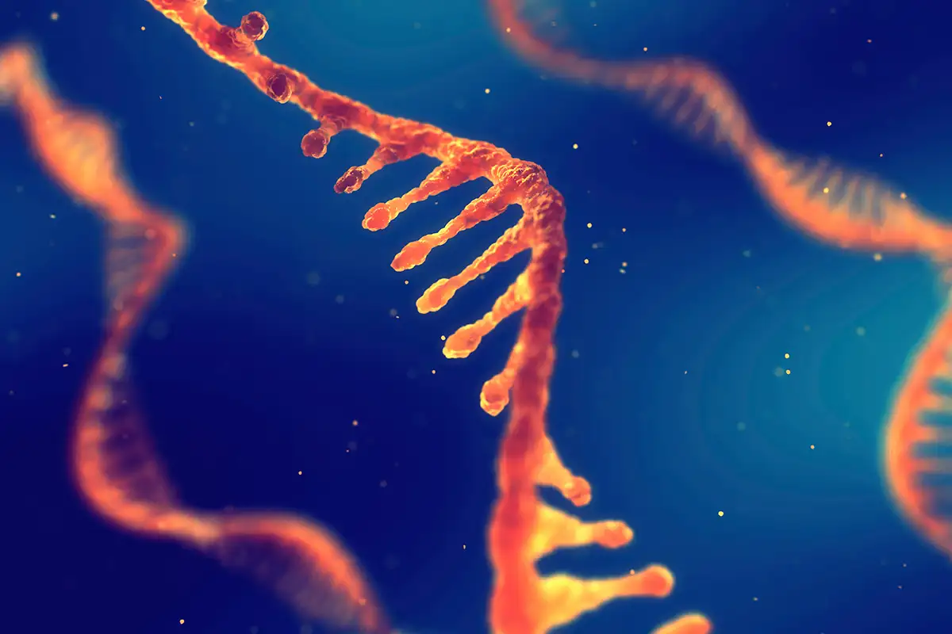
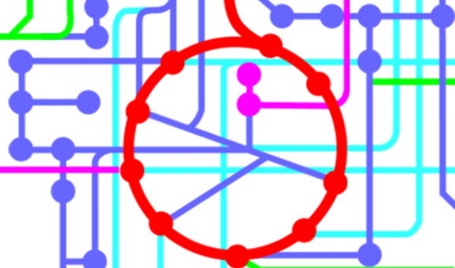
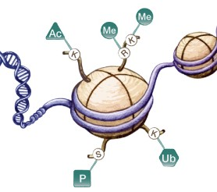
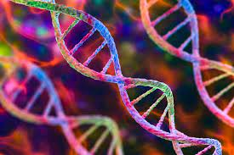
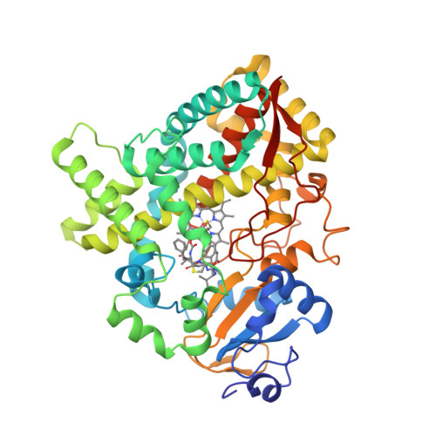
Questions

